Slide 1
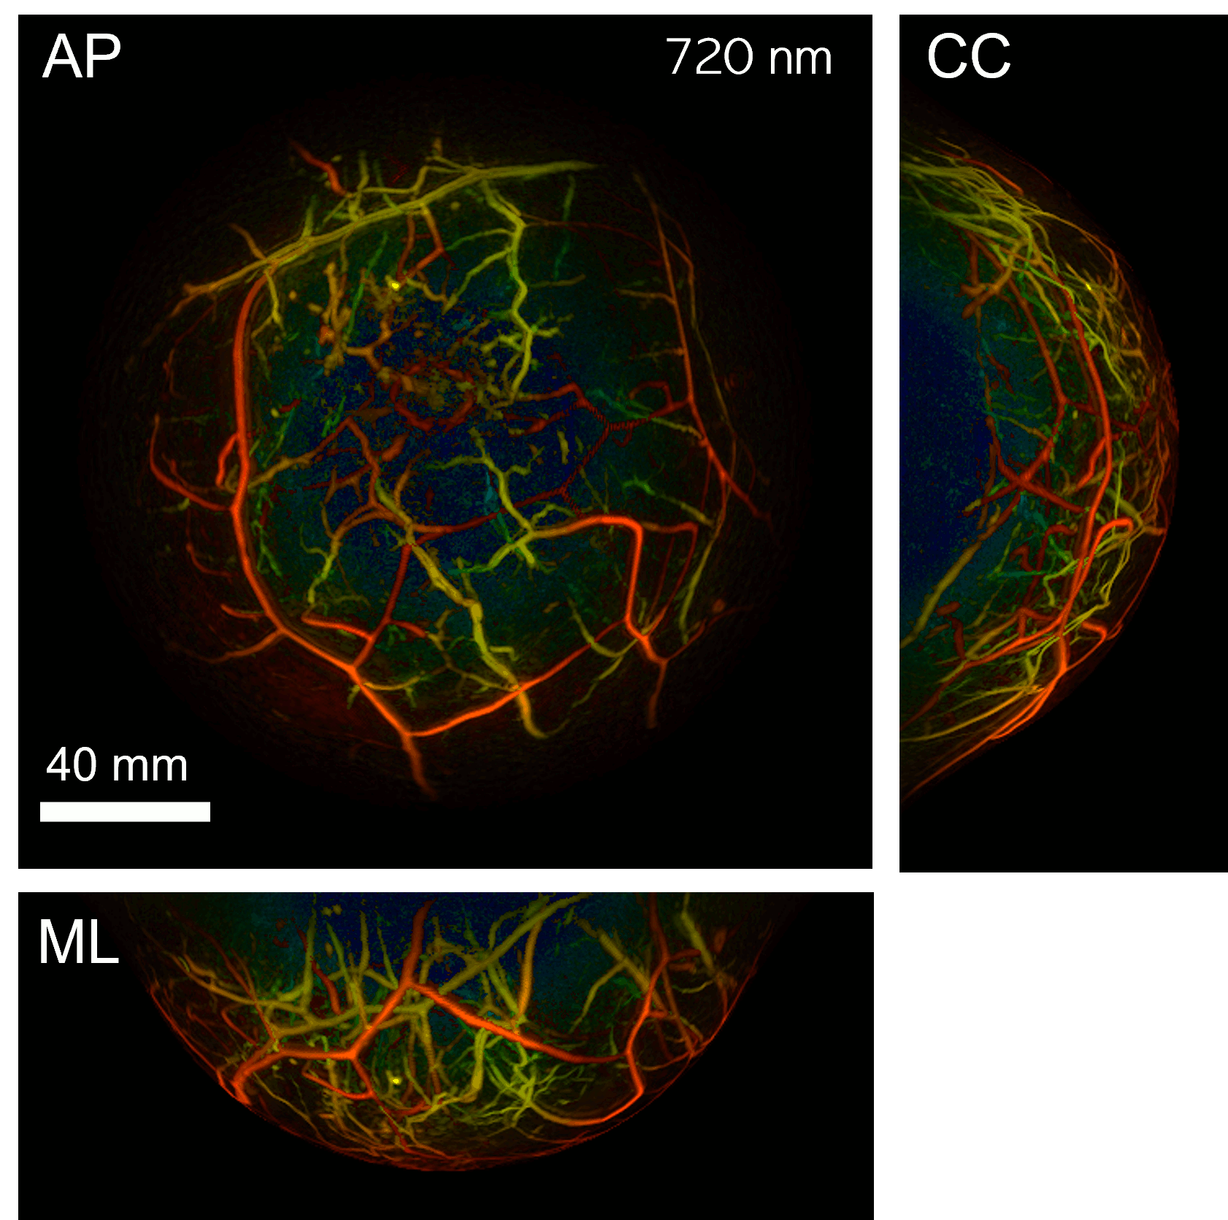
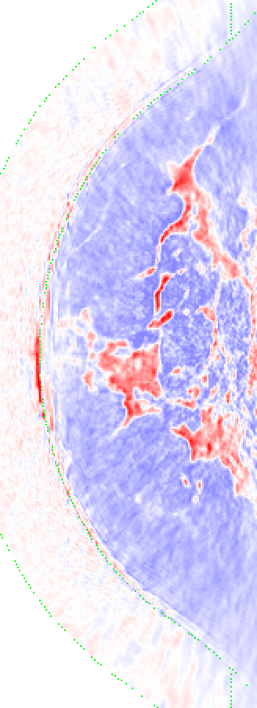
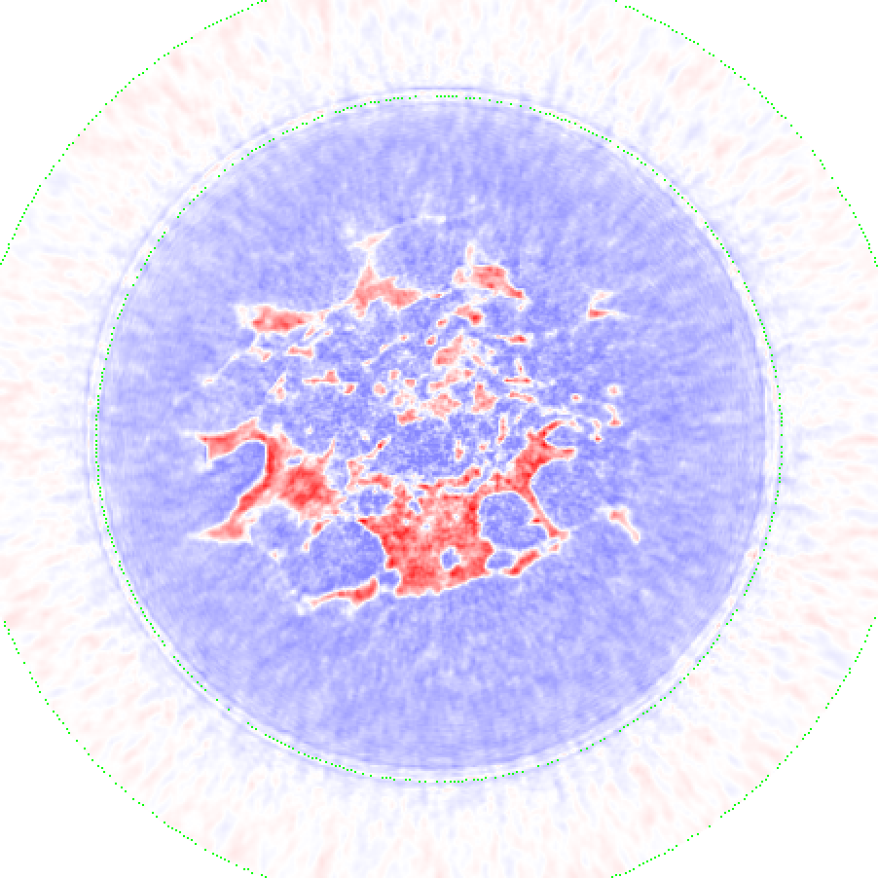
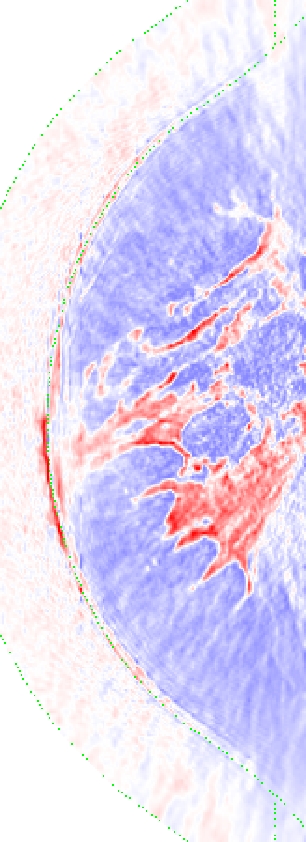
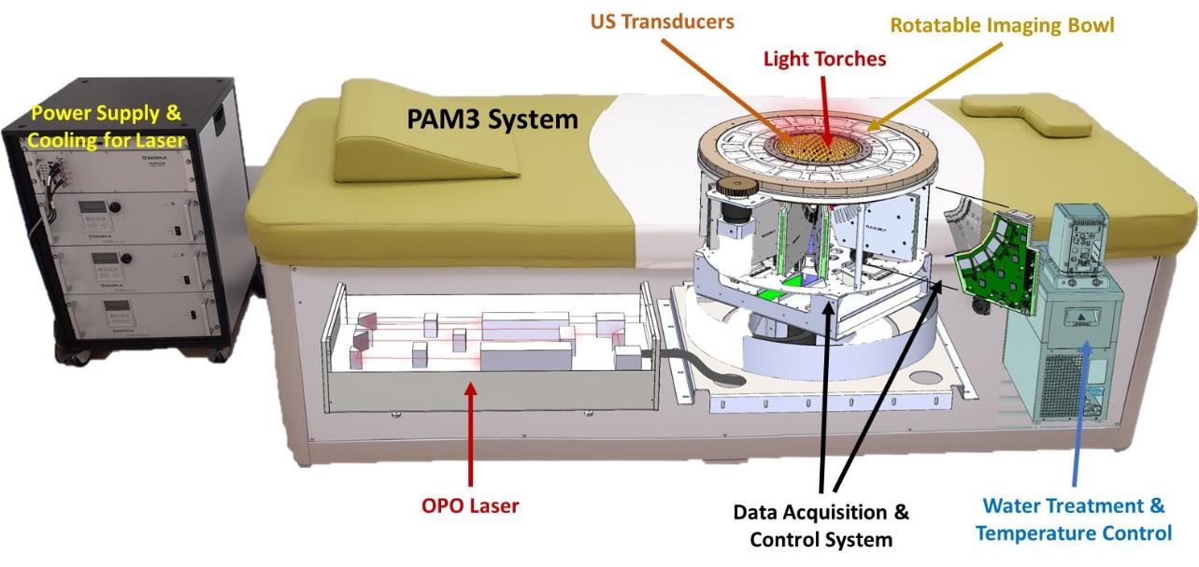
Photoacoustic and Ultrasonic Tomography for Breast Imaging
Felix Lucka*, Ben Cox &
the PAMMOTH team (*he/him, felix.lucka@cwi.nl)
Medical Physics Seminar @ MLU Halle-Wittenberg, 16th Nov 2023

Slide 2

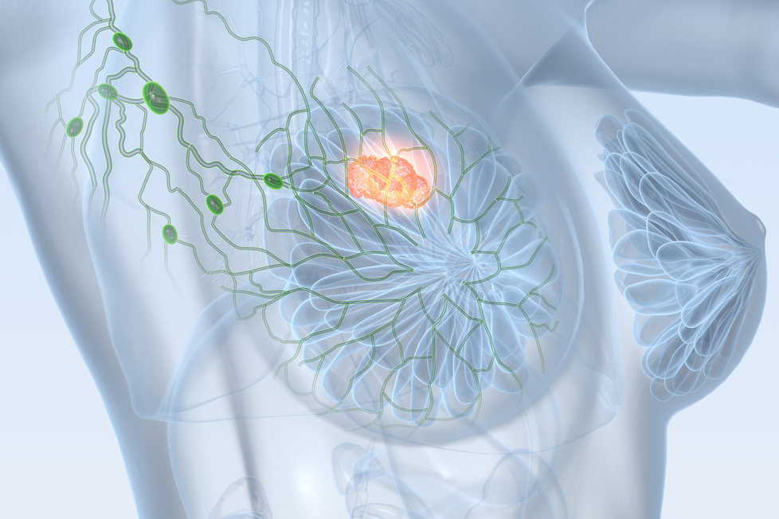
Breast Cancer
Most common cause of cancer death in women worldwide:
25% of all cancer cases
15% of all cancer deaths
Early detection and diagnosis are key to successful treatment!

Slide 3
Conventional Breast Imaging
Magnetic resonance imaging
contrast agent
expensive
availability
not suitable for every woman
Urgent need for novel imaging techniques providing higher specificity, contrast and image resolution than X-ray mammography at lower costs than MRI.
X-ray mammography
painful compression
ionizing radiation (tumor induction)
glandular tissue is problematic
Ultrasonography
whole breast imaging is difficult
operator dependent
courtesy of Rianne Bulthuis and Maura Dantuma

Slide 4
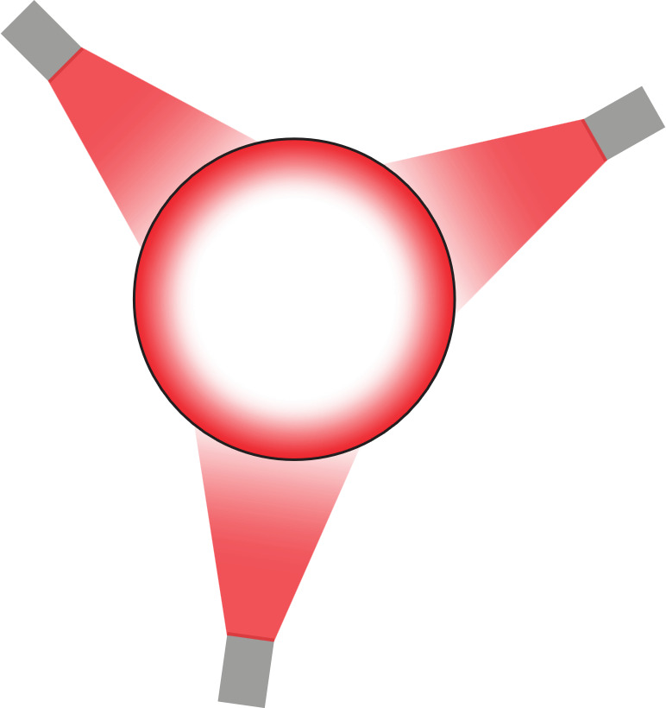
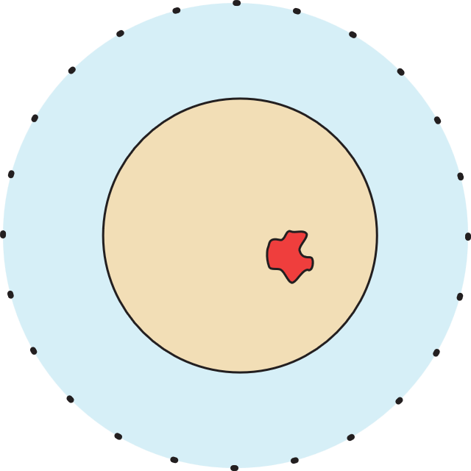
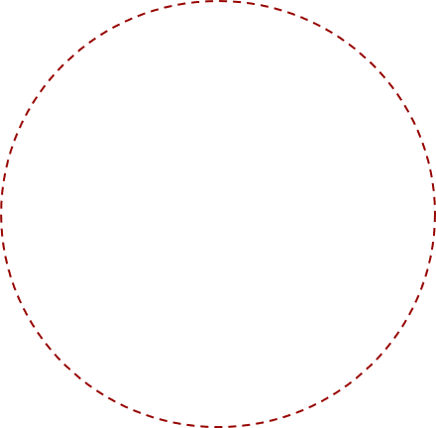
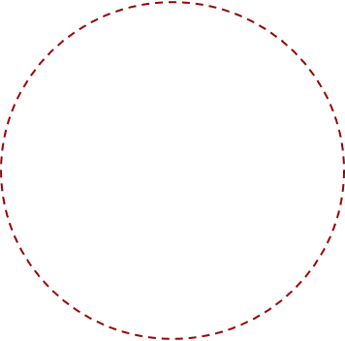



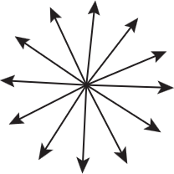

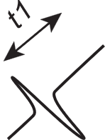
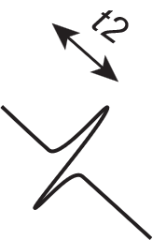
Photoacoustic Tomography (PAT)
Hybrid imaging: light in, sound out
non-ionizing, near-infrared radiation
quantitative images of optical properties
novel diagnostic information
adapted from Rianne Bulthuis and Maura Dantuma

Slide 5
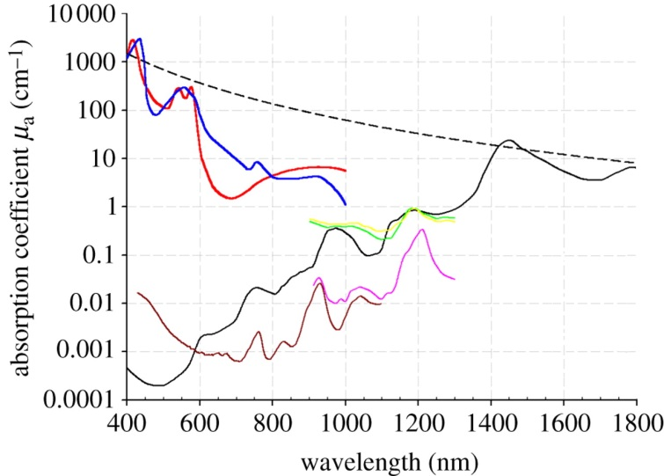
Photoacoustic Imaging: Spectral Properties
Oxyhemoglobin
Deoxyhemoglobin
Elastin
Collagen
Lipid (a) (b)
Water
(from Beard, 2011)
different wavelengths allow quantitative spectroscopic examinations
gap between oxygenated and deoxygenated blood
use of contrast agents for molecular imaging

Slide 6
Ultrasound Tomography (UST)
sound in, sound out
different from conventional US but as safe
quantitative images of acoustic properties
novel diagnostic information
adapted from Rianne Bulthuis and Maura Dantuma

Slide 7
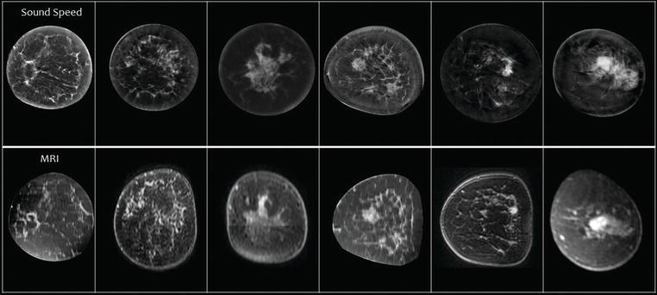
Speed of Sound vs MRI Images
From: Duric, Littrup, 2017. Breast Ultrasound Tomography, IntechOpen

Slide 8
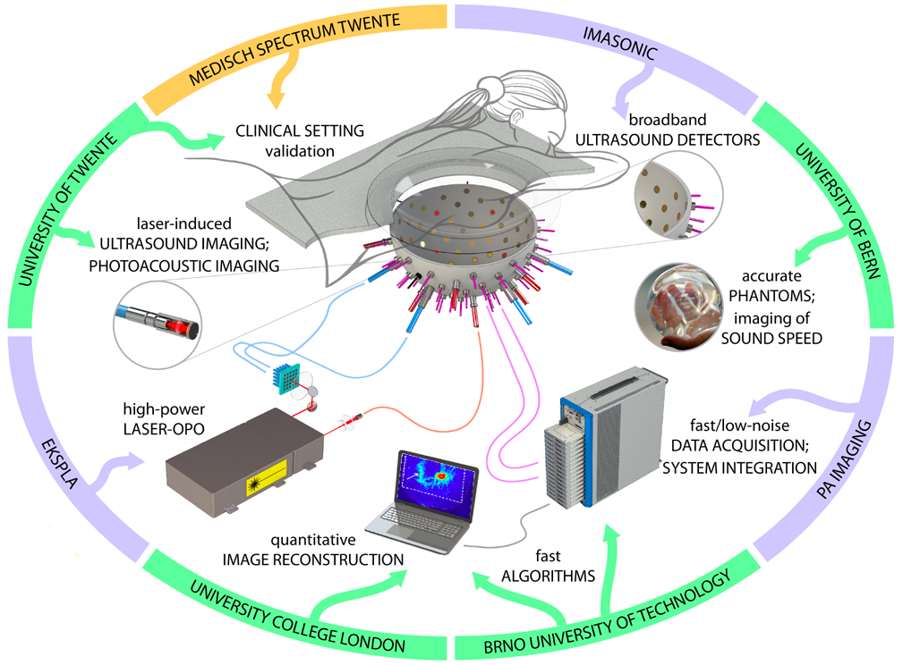
H2020: PAMMOTH
Combined PAT+UST scanner to obtain novel diagnostic information from high resolution maps of optical and acoustic properties

Slide 9

PAM3 System

Slide 10
Our Contributions
simulation studies for
ultrasonic transducer specification
light excitation design
sensing pattern design
measurement protocol design
reconstruction algorithm design
accuracy vs. computational time/resources/complexity
scanner modelling
assist high performance computing implementation
assist phantom & calibration design
process data, refine measurement procedures

Slide 11
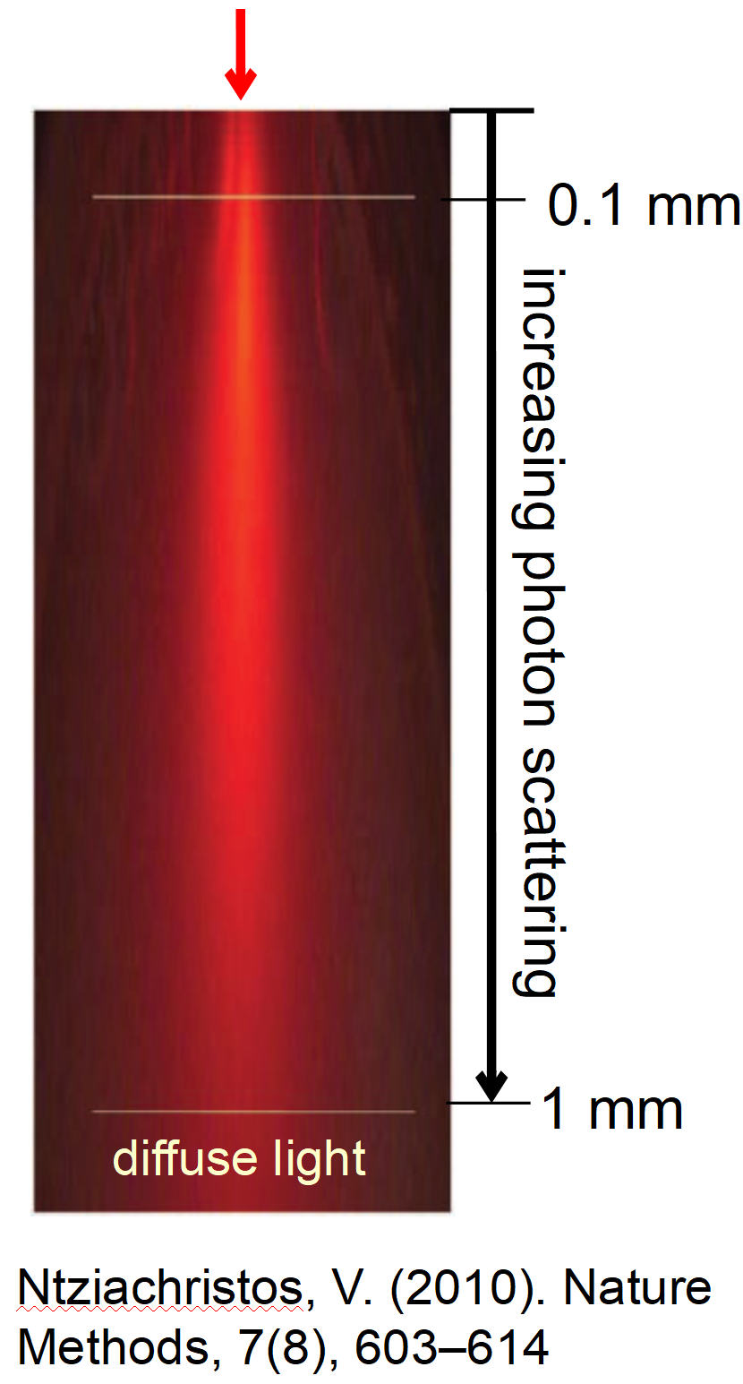


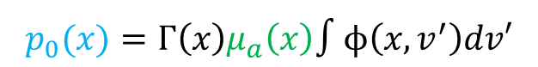
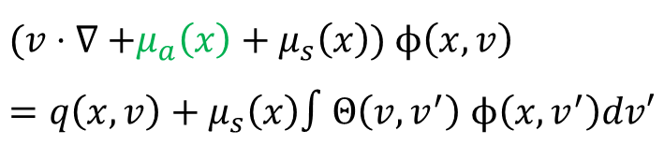

PAT: Mathematical Modelling
radiative transfer equation (RTE)
photoacoustic effect
acoustic wave equation
(assuming thermal and stress confinement conditions)
measurement (on boundary)
two coupled inverse problems:
acoustic initial value problem with boundary data.
optical parameter identification with internal data.
$$(v⋅∇\text{ +}μ_{a}\left(x\right)+μ_{s}\left(x\right)\text{) }ϕ\left(x,v\right)=q\left(x,v\right)+μ_{s}\left(x\right)∫Θ\left(v,v^{′}\right) ϕ\left(x,v^{′}\right)dv′$$
$$p_{0}(x)=Γ\left(x\right)μ_{a}\left(x\right)∫ϕ\left(x,v^{′}\right)dv′$$
$$\left(c{\left(x\right)}^{−2} ∂_{t}^{2}−Δ\right) p\left(x, t\right)=0, p\left(x,0\right)=p_{0}\left(x\right), ∂_{t}p\left(x,0\right)=0$$
$$f= Mp$$
$$f→p_{0}$$
$$p_{0}→μ_{a}$$

Slide 12
PAT Image Reconstruction – General Considerations
Imaging goal - what do we want?
qualitative (structural) or quantitative images?
fast (real-time?) image formation?
Data properties - where and how did we measure the data?
sensing geometry – planar, cylindrical, (half-)spherical
spatio-temporal sampling rates, compression?
sensor response, noise level
Wave propagation model - how realistic do we need to be?
need to include sound speed / density variations?
need to account for absorption?
include shear waves?
What else?
available computing hardware?
pre- and postprocessing

Slide 13
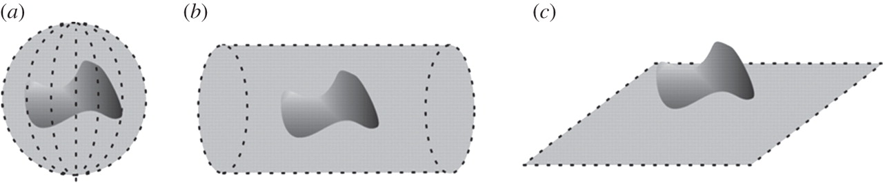
PAT Sensing Geometries
taken from: Paul Beard Interface Focus 2011;1:602-631
What is their difference?

Slide 14
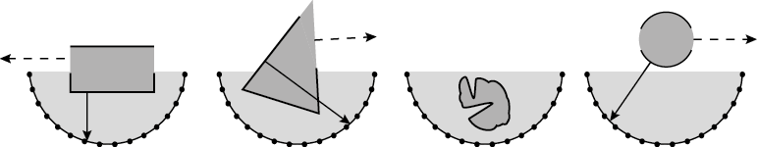
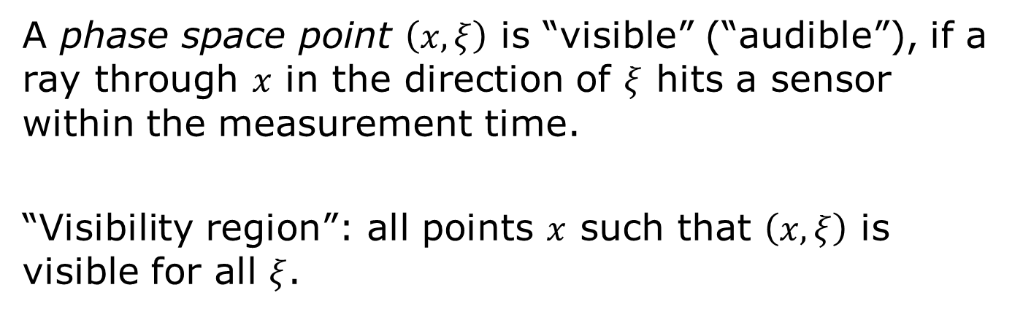
PAT Visibility Condition
visibility region
taken from: Xu, Y. et al. (2004). Med. Phys., 31(4), 724.
A phase space point $\left(x, ξ\right)$ is “visible” (“audible”), if a ray through $x$ in the direction of $ξ$ hits a sensor within the measurement time.
“Visibility region”: all points $x$ such that $\left(x, ξ\right)$ is visible for all $ξ$.

Slide 15
PAT Reconstruction Approaches
Ad-hoc back-projection / delay-and-sum / beamforming
early approaches translated from US imaging
simple geometric space-time correspondence
efficient & fast to implement
Analytical methods / series solutions
based on rigorous mathematics
exact for certain geometries and conditions
sometimes fast implementations (FFTs)
Model-based (algebraic / iterative / variational / Bayesian)
flexible, minimal conditions, sparse / compressed data
explicit numerical forward model, a-priori information
computationally heavy (high-res 3D?)
Learned / data-driven (machine/deep learning)
improve certain aspect of traditional approaches
use training data to learn good inversion / image representation

Slide 16

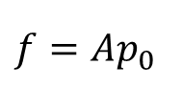
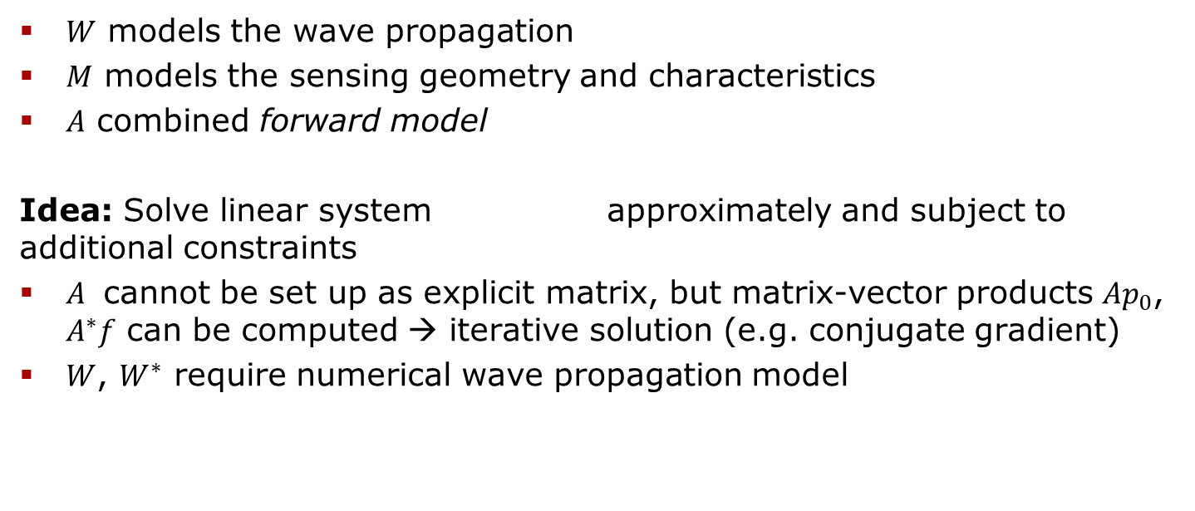
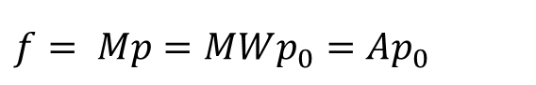
Model-Based Approaches
$$\left(c{\left(x\right)}^{−2} ∂_{t}^{2}−Δ\right) p\left(x, t\right)=0, p\left(x,0\right)=p_{0}\left(x\right), f= Mp$$
$$f= Mp=MWp_{0}=Ap_{0}$$
$W$ models the wave propagation
$M$ models the sensing geometry and characteristics
$A$ combined forward model
Idea: Solve linear system approximately and subject to additional constraints
$A$ cannot be set up as explicit matrix, but matrix-vector products $Ap_{0}$, $A^{∗}f$ can be computed → iterative solution (e.g. conjugate gradient)
$W$, $W^{∗}$ require numerical wave propagation model
$$f=Ap_{0}$$
Arridge, Betcke, Cox, L, Treeby, 2016. On the Adjoint Operator in Photoacoustic Tomography. Inverse Problems

Slide 17
Acoustic Wave Solvers
Direct methods
finite-difference
pseudospectral
finite/spectral element
discontinous Galerkin
Integral equation methods
boundary element
Asymptotic methods
geometrical optics
Gaussian beams
Time domain vs. frequency domain

Slide 18
k-Wave
Time-domain k-space pseudospectral method solving the underlying system of first order conservation laws
compute spatial derivatives via 3D FFTs
parallel/GPU computing
modify finite temporal differences by k-space operator + staggered grids for accuracy and robustness
perfectly matched layer → free-space propagation
Treeby, Cox, 2010. k-Wave: MATLAB toolbox for the simulation and reconstruction of photoacoustic wave fields. Journal of Biomedical Optics

Slide 19
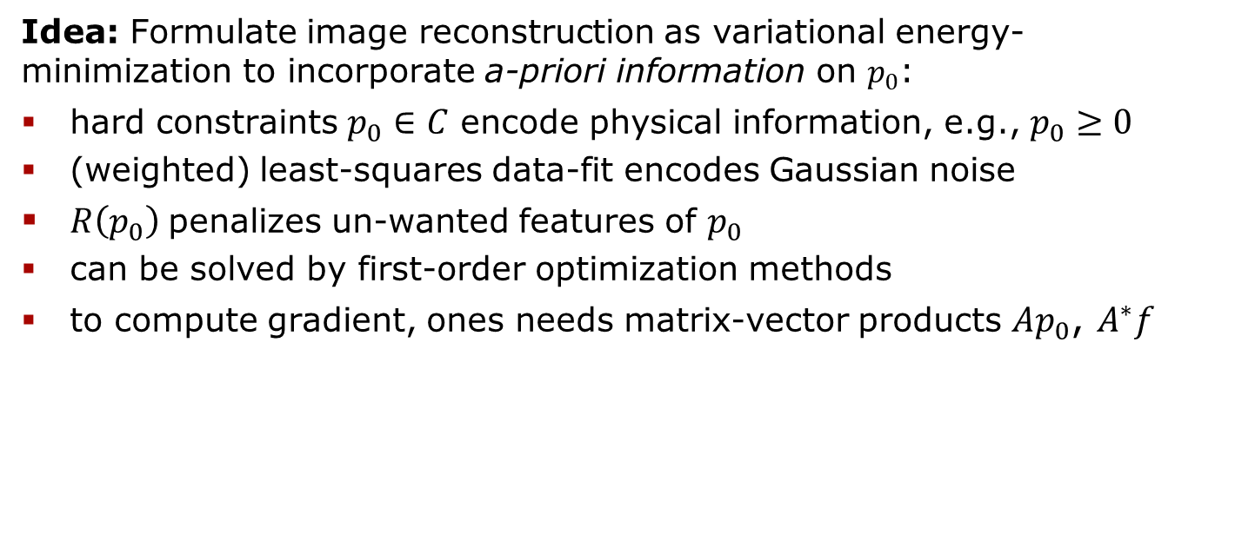
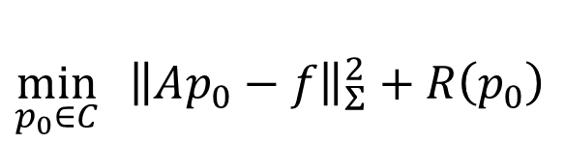
Variational Regularization Approaches
$$\min_{p_{0}∈C}{ {\left\|Ap_{0}−f\right\|}_{Σ}^{2}+R\left(p_{0}\right)}$$
Idea: Formulate image reconstruction as variational energy-minimization to incorporate a-priori information on $p_{0}$:
hard constraints $p_{0}∈C$ encode physical information, e.g., $p_{0}≥0$
(weighted) least-squares data-fit encodes Gaussian noise
$R\left(p_{0}\right)$penalizes un-wanted features of $p_{0}$
can be solved by first-order optimization methods
to compute gradient, ones needs matrix-vector products $Ap_{0}$, $A^{∗}f$
Chambolle, Pock, 2016. An introduction to continuous optimization for imaging. Acta Numerica

Slide 20
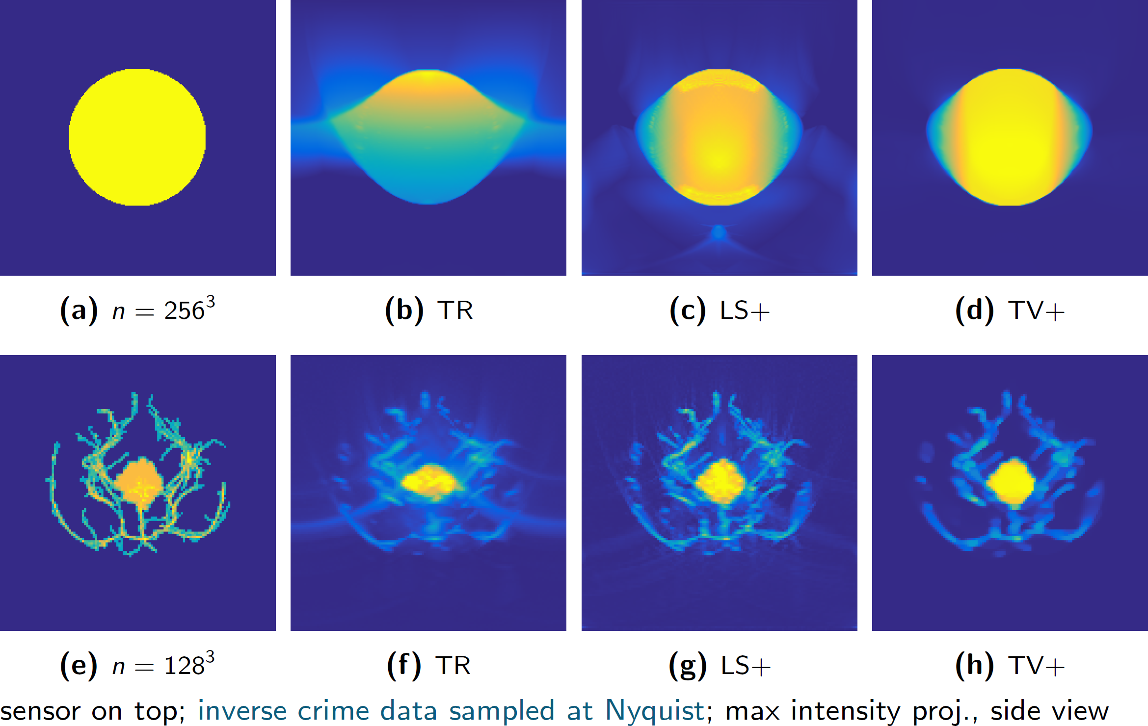
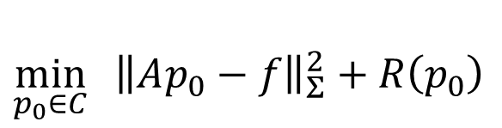
Comparison for One-Sided Sensor Data
$$\min_{p_{0}∈C}{ {\left\|Ap_{0}−f\right\|}_{Σ}^{2}+R\left(p_{0}\right)}$$

Slide 21
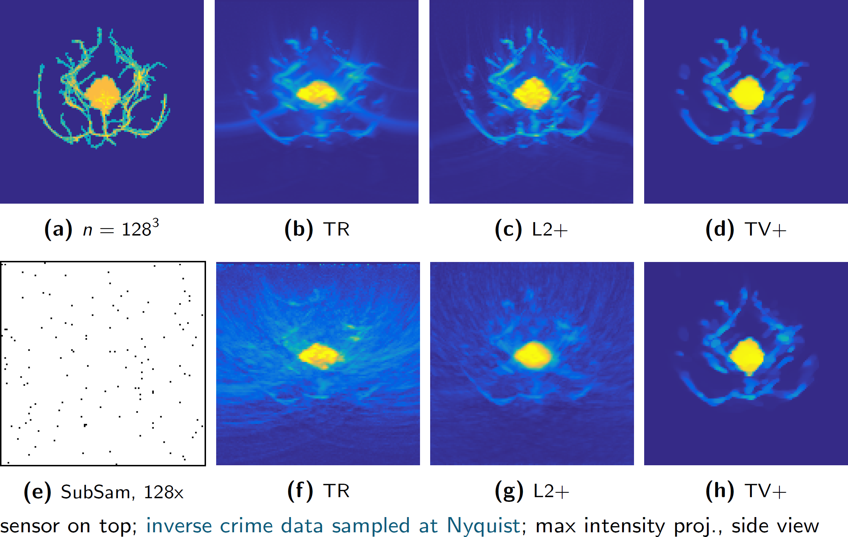
Comparison for Sub-Sampled Data
$$\min_{p_{0}∈C}{ {\left\|Ap_{0}−f\right\|}_{Σ}^{2}+R\left(p_{0}\right)}$$

Slide 22
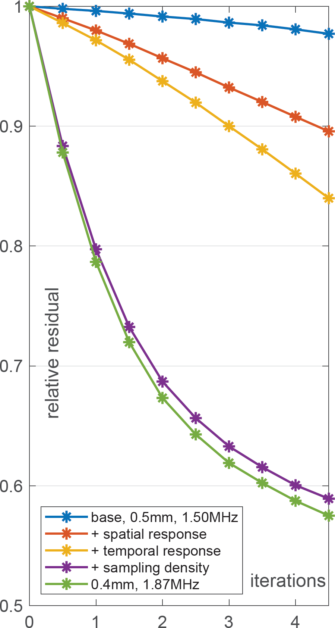
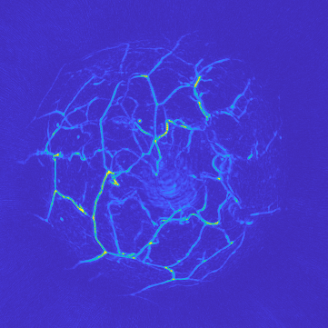
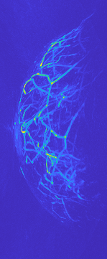
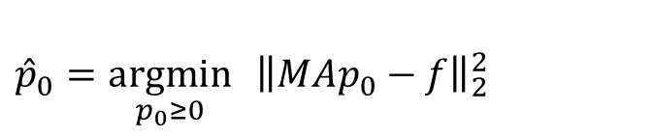
PAMMOTH modeling, baseline
$${\hat{p}}_{0}=\underset{p_{0}≥0}{argmin}{ {\left\|MAp_{0}−f\right\|}_{2}^{2}}$$
Notes:
SOS model: cup

Slide 23
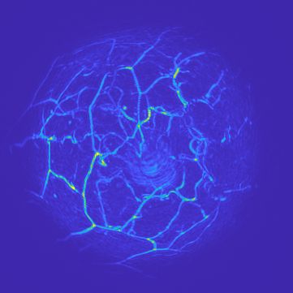
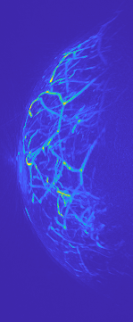
PAMMOTH modeling, + spatial response
$${\hat{p}}_{0}=\underset{p_{0}≥0}{argmin}{ {\left\|MAp_{0}−f\right\|}_{2}^{2}}$$
Notes:
SOS model: cup

Slide 24
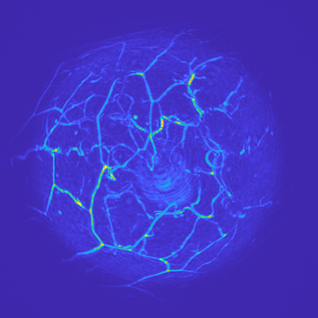
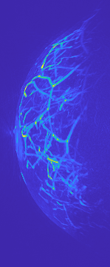
PAMMOTH modeling, + temporal response
$${\hat{p}}_{0}=\underset{p_{0}≥0}{argmin}{ {\left\|MAp_{0}−f\right\|}_{2}^{2}}$$
Notes:
SOS model: cup

Slide 25
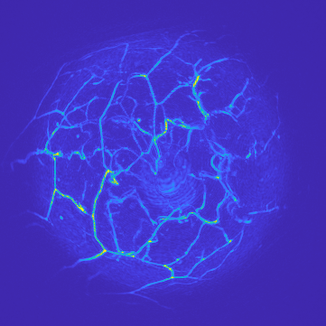
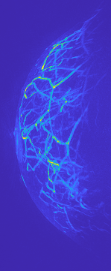
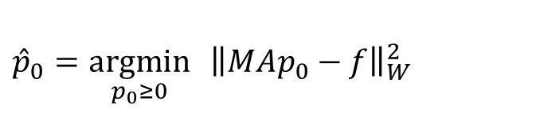
PAMMOTH modeling, + sampling density
$${\hat{p}}_{0}=\underset{p_{0}≥0}{argmin}{ {\left\|MAp_{0}−f\right\|}_{W}^{2}}$$
Notes:
SOS model: cup

Slide 26
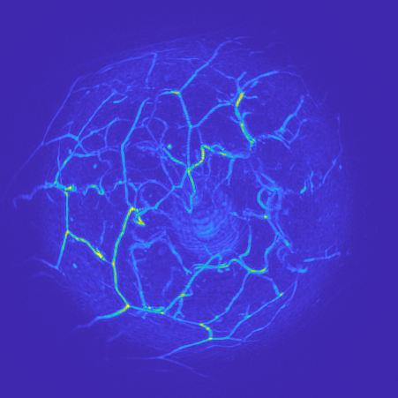

PAMMOTH modeling, higher resolution
$${\hat{p}}_{0}=\underset{p_{0}≥0}{argmin}{ {\left\|MAp_{0}−f\right\|}_{W}^{2}}$$
Notes:
SOS model: cup

Slide 27
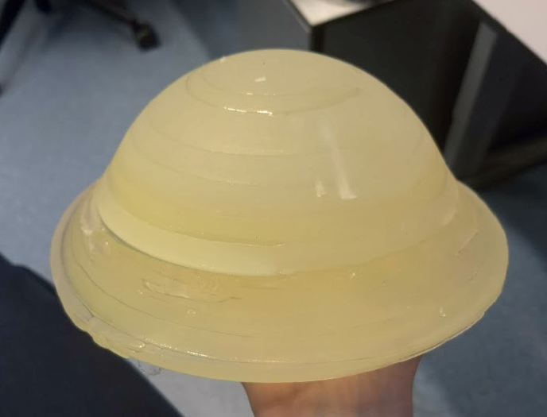
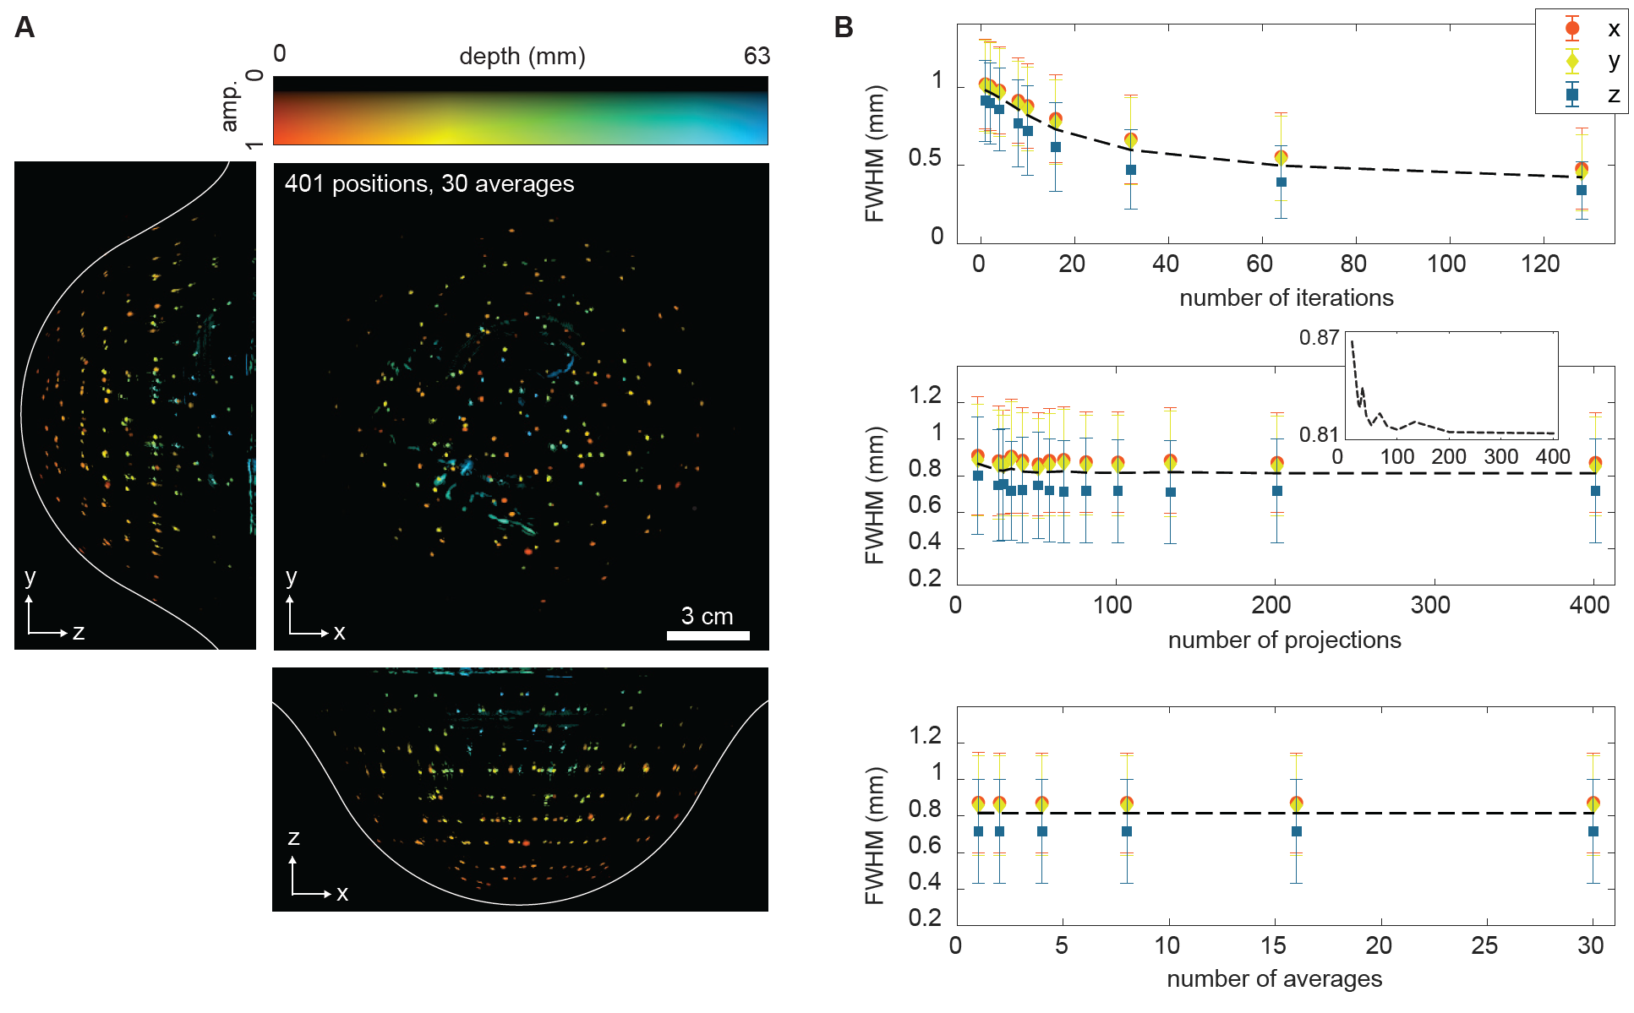
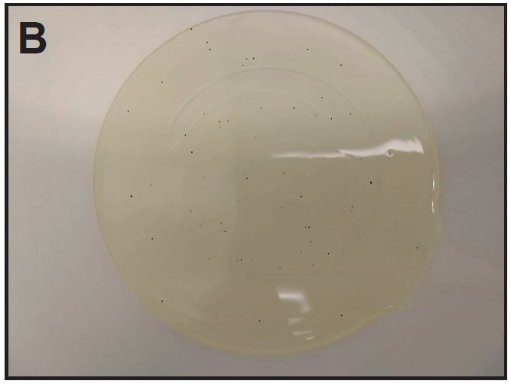
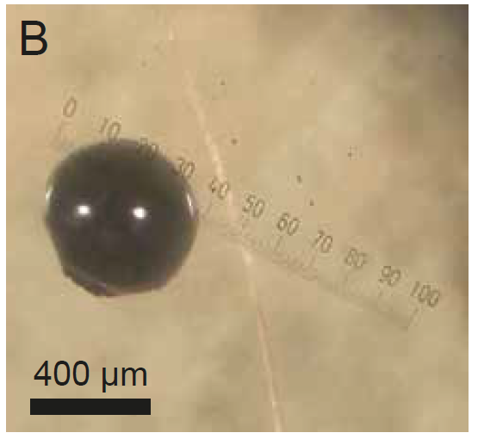
Illustration: Phantom Validation

Slide 28
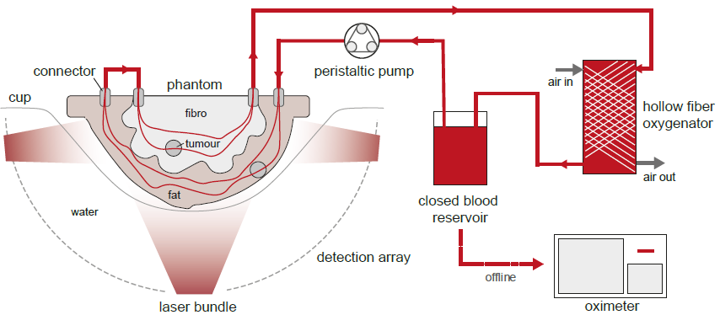
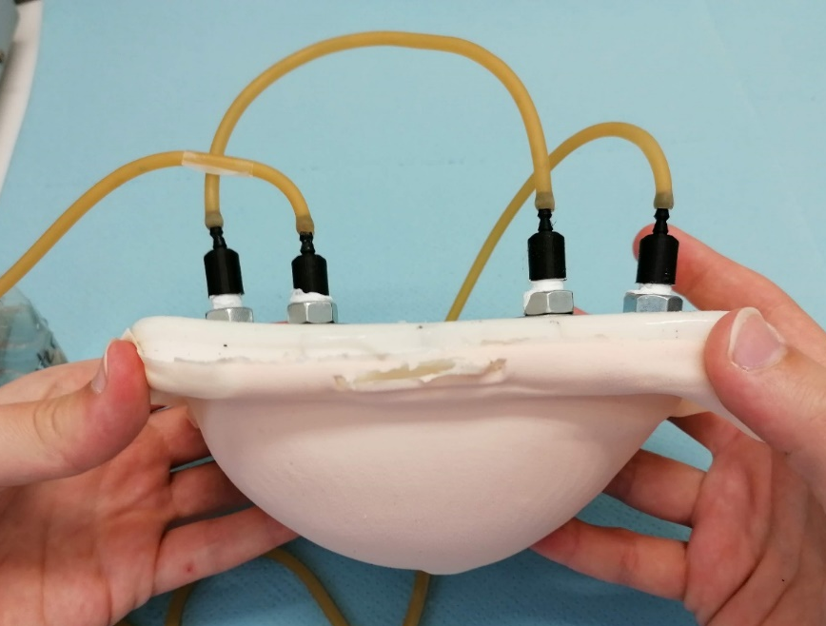
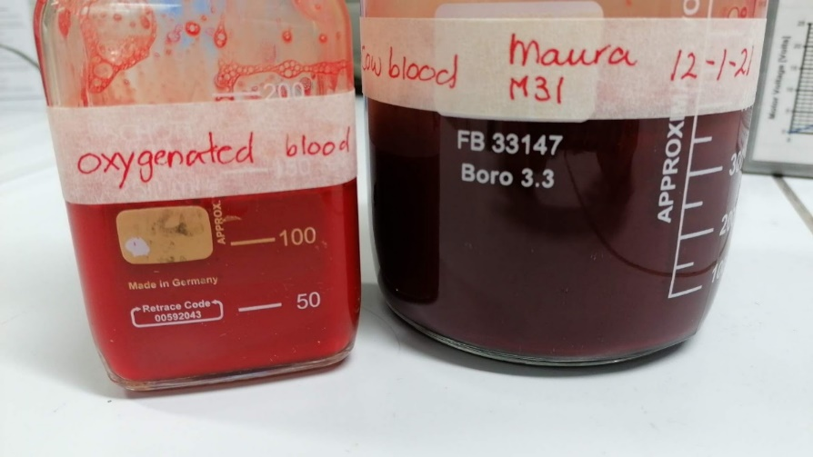
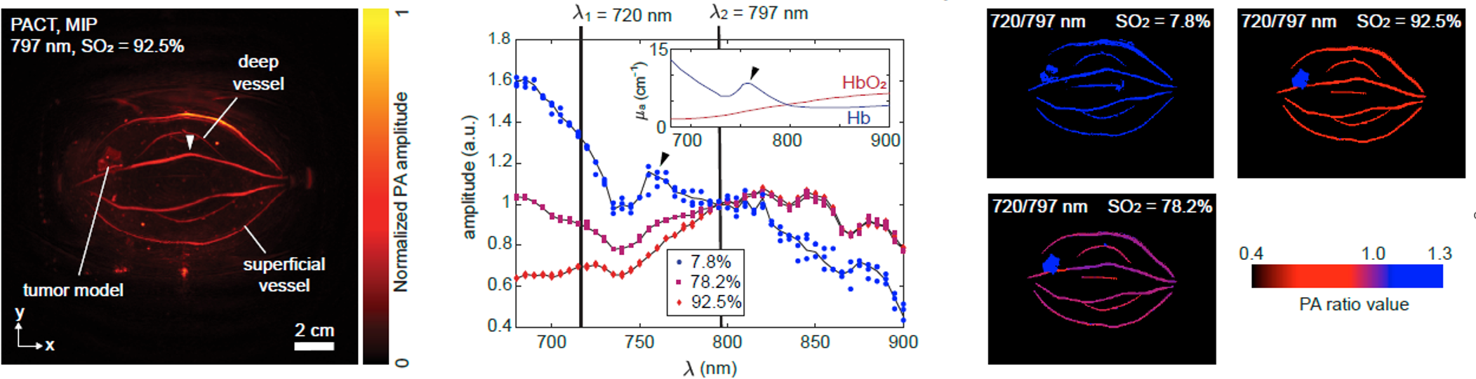
Illustration: Phantom Validation

Slide 29



Illustration: In Vivo Results
>1
Intensity ratio 890 nm / 720 nm
<1
Figure from: Spectrum Medical, Non-Invasive Measurement of SaO₂, SvO₂ & Hemoglobin

Slide 30

How deep can we image?
medial-lateral depth color-coded PAT MIPs
48 mm
Increasing depth from skin

Slide 31




UST: Mathematical Modelling (simplified)
acoustic wave equation
measurement (on boundary)
multiple sources
inverse problem:
acoustic parameter identification problem with boundary data.
$$\left(c{\left(x\right)}^{−2} ∂_{t}^{2}−Δ\right) p_{i}\left(x, t\right)=s_{i}\left(x,t\right)$$
$$f_{i}= M_{i}p_{i}$$
$$i=1, …, N_{s}$$
$$f→c$$

Slide 32
UST Reconstruction Approaches
Travel time tomography: geometrical optics approximation
robust & computationally efficient (time-of-flight picking followed by linear inversion)
valid for high frequencies (attenuation!), low res, lots of data
Javaherian, L, Cox, 2020. Refraction-corrected ray-based inversion for three-dimensional ultrasound tomography of the breast. Inverse Problems
Full waveform inversion (FWI): fit full wave model to all data
high res from little data, transducer modelling, constraints
many wave simulations, complex numerical optimization
lower TRL but already used in 2D systems
our system is not designed for it

Slide 33




Time Domain Full Waveform Inversion
$\min_{c∈C}{\sum_{i}^{N_{S}}{ℓ(\tilde{f_{i}}\left(c\right), f_{i})}}$, s.t. $\tilde{f_{i}}\left(c\right)=M_{i}p_{i} ∧ \left(c^{−2} ∂_{t}^{2}−Δ\right) p_{i}=s_{i}$
gradient for first-order optimization via adjoint state method
where is the time-reversed data discrepancy
two wave simulations for one gradient (for one source ☹)
Starting point in 2D:
$$∇_{c}ℓ\left(\tilde{f}\left(c\right), f\right)\text{= }\text{2 }\int_{0}^{T}{{c\left(x\right)}^{−3} ∂_{t}^{2}p\left(x,t\right) q^{∗}\left(x, t\right) dt, }$$
$$\left(c^{−2} ∂_{t}^{2}−Δ\right) q^{∗}=s^{∗},$$
$$s^{∗}(x,t)$$
Pérez-Liva, Herraiz, Udías, Miller, Cox, Treeby, 2017. Time domain reconstruction of sound speed and attenuation in ultrasound computed tomography using full wave inversion. JASA

Slide 34


3D Time Domain FWI for Breast UST
$\min_{c∈C}{\sum_{i}^{N_{S}}{ℓ(\tilde{f_{i}}\left(c\right), f_{i})}}$, $∇_{c}ℓ\left(\tilde{f}\left(c\right), f\right)\text{= }\text{2 }\int_{0}^{T}{{c\left(x\right)}^{−3} ∂_{t}^{2}p\left(x,t\right) q^{∗}\left(x, t\right) dt}$
Challenges and solutions for 3D:
2 x $N_{S}$ wave simulations per gradient → stochastic quasi-newton optimization (SL-BFGS)
computationally & stochastically efficient gradient estimator → source encoding for time-invariant systems
memory requirements of gradient computation → time-reversal based gradient computation
slow convergence and local minima → coarse-to-fine multigrid schemes
computational resources → runs on single GPU, can utilize multiple GPUs

Slide 35


Numerical proof-of-concept study
L, Pérez-Liva, Treeby, Cox, 2021. High Resolution 3D Ultrasonic Breast Imaging by Time-Domain Full Waveform Inversion. Inverse Problems

Slide 36




Numerical proof-of-concept study
Starting point
Improvement
L, Pérez-Liva, Treeby, Cox, 2021. High Resolution 3D Ultrasonic Breast Imaging by Time-Domain Full Waveform Inversion. Inverse Problems

Slide 37
FWI for Experimental Data: Where Are We?
data from phantom objects, volunteers & patients
ray-based travel time tomography reconstructions
photoacoustic reconstructions → data pre-processing, scanner & transducer modelling, wave simulations
modeling of US protocol, data read-in & pre-processing
model calibration
FWI of phantom objects, quantitative evaluation
FWI of volunteer / patient data
Clinical evaluation

Slide 38






SOS Phantom
X
Z
SOS – c_{water}
Y
-100 0 +100
Notes:
50.000 source activations

Slide 39



SOS Phantom: Travel Time Tomography
X
Z
X
Z
SOS – c_{water}
SOS – c_{water}
Y
Y
Y
2.0mm grid; (bent-ray)
-100 0 +100
Notes:
ToDo: Redo images, they don‘t seem to be aligned

Slide 40



SOS Phantom: FWI
X
Z
X
Z
SOS – c_{water}
SOS – c_{water}
Y
Y
Y
2.0 mm grid, 0.37/0.21 MHz, 0.22% original signal
-100 0 +100

Slide 41



SOS Phantom: FWI
X
Z
X
Z
SOS – c_{water}
SOS – c_{water}
Y
Y
Y
1.5 mm grid, 0.50/0.28 MHz, 0.52% original signal
-100 0 +100

Slide 42



SOS Phantom: FWI
X
Z
X
Z
SOS – c_{water}
SOS – c_{water}
Y
Y
Y
1.0 mm grid, 0.75/0.42 MHz, 2.47% original signal
-100 0 +100

Slide 43



SOS Phantom: FWI
X
Z
X
Z
SOS – c_{water}
SOS – c_{water}
Y
Y
Y
0.8 mm grid, 0.94/0.53 MHz, 6.55% original signal
-100 0 +100

Slide 44



SOS Phantom: FWI
X
Z
X
Z
SOS – c_{water}
SOS – c_{water}
Y
Y
Y
0.6 mm grid, 1.25/0.71 MHz, 21.35% original signal
-100 0 +100
Notes:
This the last result I got. In principle, we can go down to 0.4 mm grids, so I’ll continue a bit. One can see that you get high resolution features, sharp boundaries and a larger field of view compared to the TOF reconstruction. The image contains a few artifacts. Some of them come from the phantom design (reflections from the airsurface, there is another breast cup in there that I did not know about, the interface between the oil and PAA has areas of higher and lower density and gaps in acoustic coupling).

Slide 45



In Vivo Results: TTT
X
Z
SOS – c_{water}
2.0mm grid
bent ray
Y
-100 0 +100

Slide 46



In Vivo Results FWI
X
Z
SOS – c_{water}
2.0mm grid
0.22% original signal
Y
-100 0 +100

Slide 47



In Vivo Results FWI
X
Z
SOS – c_{water}
1.5mm grid
0.52% original signal
Y
-100 0 +100

Slide 48



In Vivo Results FWI
X
Z
SOS – c_{water}
1.0mm grid
2.47% original signal
Y
-100 0 +100

Slide 49



In Vivo Results FWI
X
Z
SOS – c_{water}
0.8mm grid
6.55% original signal
Y
-100 0 +100

Slide 50



In Vivo Results FWI
X
Z
SOS – c_{water}
0.6mm grid
21.35% original signal
Y
-100 0 +100

Slide 51
In Vivo Results FWI
X
Z
PAT shows that these three dots are blood vessels
SOS – c_{water}
0.4mm grid
65.46% original signal
Y
-100 0 +100

Slide 52






Improvement (up to now…)
X
Z
X
Z
SOS – c_{water}
SOS – c_{water}
Y
Y
Y
-100 0 +100

Slide 53
Improvement (up to now…)
X
Z
X
Z
SOS – c_{water}
SOS – c_{water}
Y
Y
Y
-100 0 +100
Notes:
What I find amazing is that this improvement relies on using a mathematical model of wave-matter interaction with the help a big bag of applied mathematics tricks: From numerical wave propagation, stochastic optimization, multi-grid schemes and other things.

Slide 54



Using 2SOS model in PAT
Notes:
Colour codes depth, everything above 3cm is clipped off

Slide 55



Using TOF model in PAT
Notes:
Colour codes depth, everything above 3cm is clipped off

Slide 56



Using FWI model in PAT
Notes:
Colour codes depth, everything above 3cm is clipped off

Slide 57





Summary & Outlook
need for novel breast imaging techniques
photoacoustic (PAT) and ultrasound tomography (UST) give access to high-quality images of optical and acoustic tissue properties
combined PAT+UST scanner designed & build
evaluation on data from phantoms, volunteers & patients
PAT reconstructions work well
proof-of-concept studies of FWI for high resolution 3D UST
demonstration of FWI on experimental data
optical inversion in PAT (QPAT)
Dantuma et al., 2023. Fully three-dimensional sound speed-corrected multi-wavelength photoacoustic breast tomography. To appear in Light: Science and Applications, arXiv:2308.06754
L, Pérez-Liva, Treeby, Cox, 2021. High Resolution 3D Ultrasonic Breast Imaging by Time-Domain Full Waveform Inversion. Inverse Problems
Felix.Lucka@cwi.nl Photoacoustic and Ultrasonic Tomography for Breast Imaging
Notes:
reconstruction of experimental data

